Slide 1
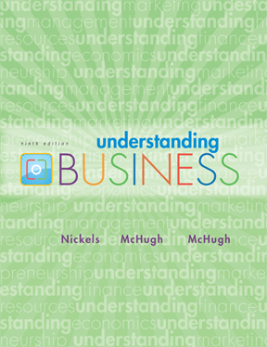

*
Chapter Four
*
Demanding Ethical and Socially Responsible Behavior
(Part-3)
McGraw-Hill/Irwin
Copyright © 2010 by The McGraw-Hill Companies, Inc. All rights reserved.

Slide 2

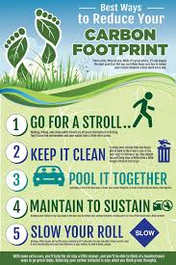



Slide 3
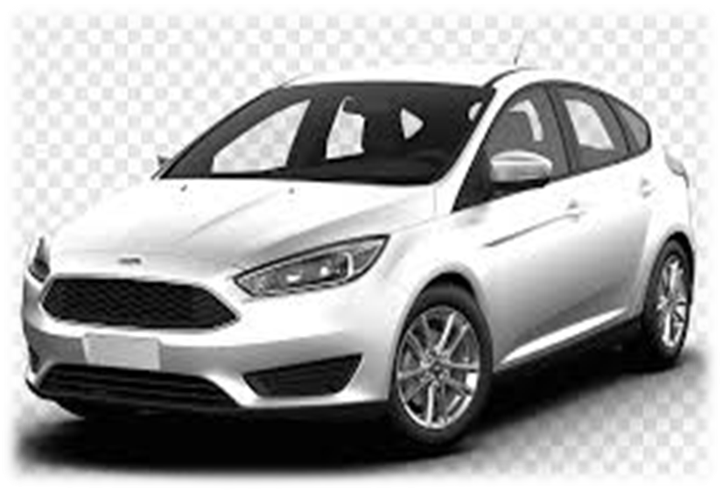
Ford plans to reduce their greenhouse gas emissions using their EcoBoost engine to increase fuel efficiency.
It also plans to introduce electric and hybrid vehicles
rely on wind sail and solar PV systems to power their locations greatly reducing their use of electricity

Slide 4
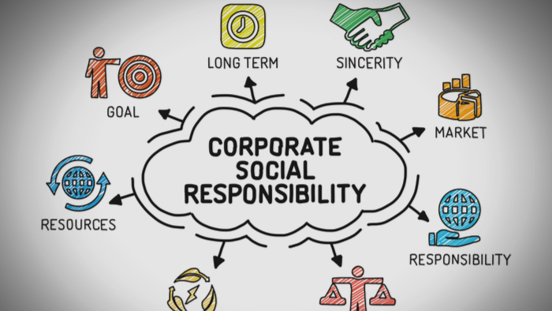

Slide 5

CRITICS OF CSR
CSR DEFENDERS

Slide 6

Studies show that companies with good ethical reputations attract and retain better employees, draw more customers, and enjoy greater employee loyalty.

Slide 7

Several Dimensions of social performance
Corporate philanthropy
Corporate social initiatives
Corporate responsibility
Corporate policy
4-<number>

Slide 8

Corporate Philanthropy

Slide 9
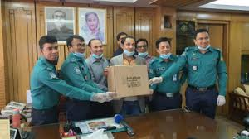
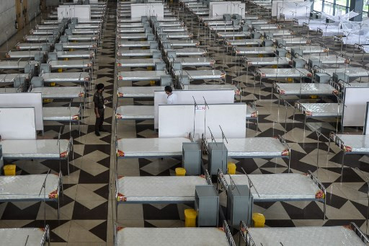


Corporate Social initiative

Slide 10
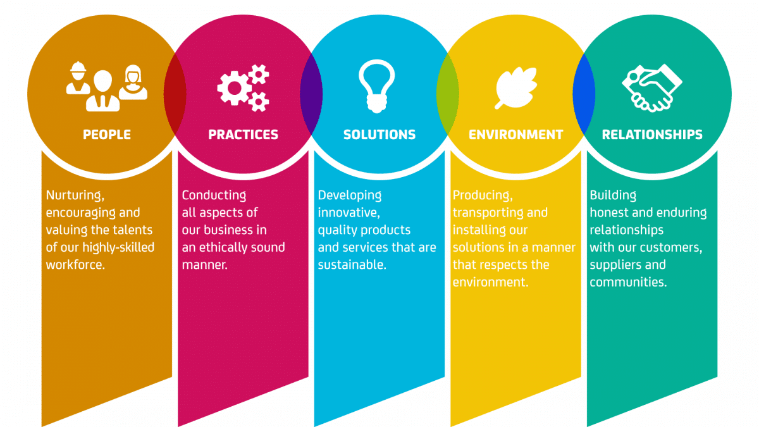
Corporate Responsibility
Acting responsibly within society.
Doing everything that’s right for the society

Slide 11

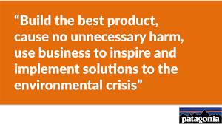

Slide 12

Mini Case Aanalysis
Read the case study and answer the question.

